Slide 1
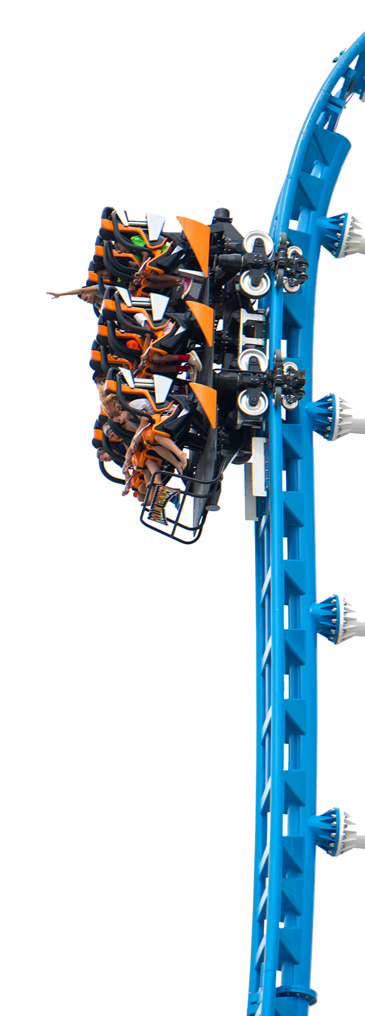

Slide 2
Newton’s First Law of Motion
An object will remain at rest or in uniform motion in a straight line unless compelled to change its state by the action of an external force.
VisitOWA.com

Slide 3
Flying Carousel and Freedom Flyer
Flying Carousel is a great example of Newton’s First Law of Motion.
Newton’s Law states that objects should travel in a straight line unless acted upon by an outside force.
Centripetal Force is what causes you to swing in a circle while riding Flying Carousel

Slide 4
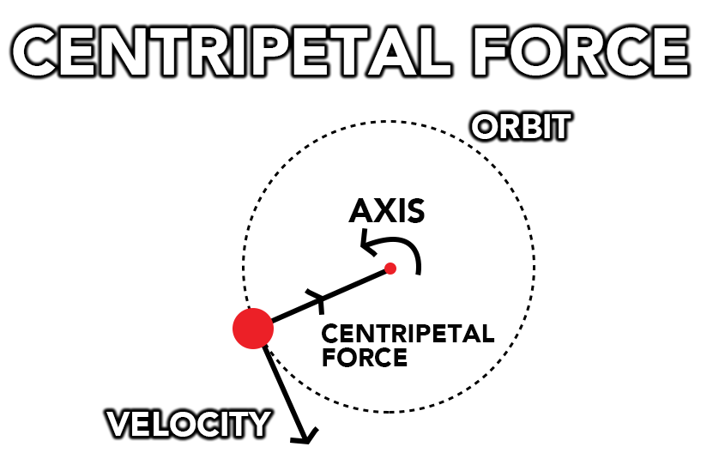
Centripetal means center seeking

Slide 5
Flying Carousel and Freedom Flyer
If you’ve ever swung a ball on a string, you know that ball will travel in a circular path.
The ball is traveling in a circular path because an outside force is acting upon the ball.
The string, which is pulling the ball back towards you, acts as centripetal force.

Slide 6
Flying Carousel and Freedom Flyer
Centripetal force means “center seeking” and it is this force that affects Freedom Flyer and Flying Carousel.
The chains from which the swings hang is the centripetal force that keeps them traveling in a circular direction as the gondola turns.

Slide 7
Centripetal Force at OWA
Centripetal force plays a part in many other rides at OWA.
From the loops and corkscrews on Rollin’ Thunder and the twists and spins of Crazy Mouse to the 360 degrees of motion on Wave Rider, Centripetal force is what makes these rides exciting.

Slide 8
VisitOWA.com

Slide 9
Review/ Follow up
Newton’s First Law states that an object in motion will travel in a straight line unless compelled to change its
state by an outside force. What force is required to make you twist and turn on many of the rides at OWA?
VisitOWA.com

Slide 10
Review/ Follow up
VisitOWA.com

Slide 11
Review/ Follow up
3. List other examples of Centripetal Force on the rides at OWA.
VisitOWA.com

Slide 12
Email Sales@VisitOWA.com or call (251) 923-3498
VisitOWA.com
Notes:
Questions/Comments

